Slide 1


Chapter 4 Core
TCP/IP Protocols

Slide 2

Chapter 4 Overview
Understanding TCP and UDP
Exploring Common Protocols
Understanding Ports

Slide 3
Understanding TCP and UDP
TCP
  Connection-oriented
  Uses three-way handshake
UDP
  Connection-less
  Uses best-effort

Slide 4
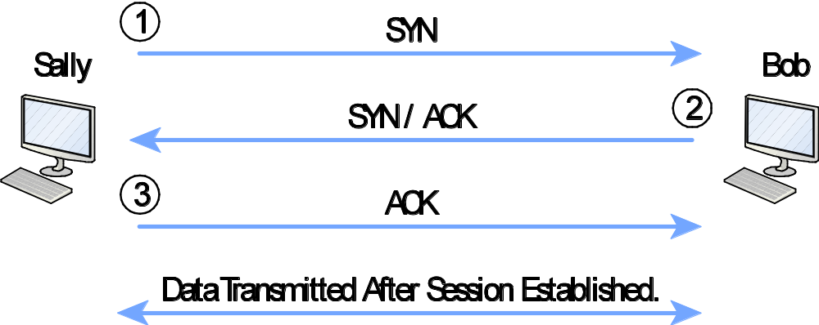
Exploring TCP
Three-way handshake

Slide 5
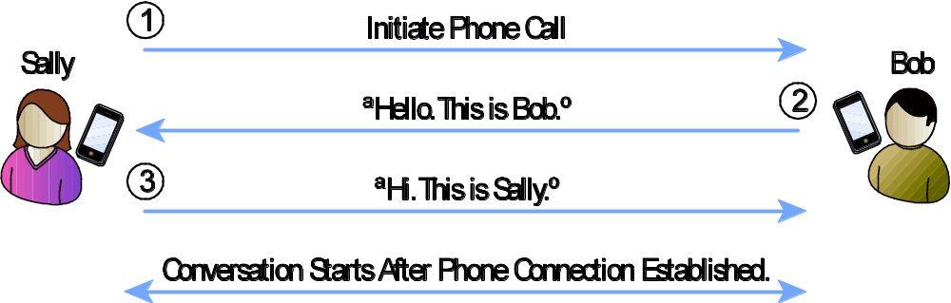
Exploring TCP
Similar to phone call

Slide 6
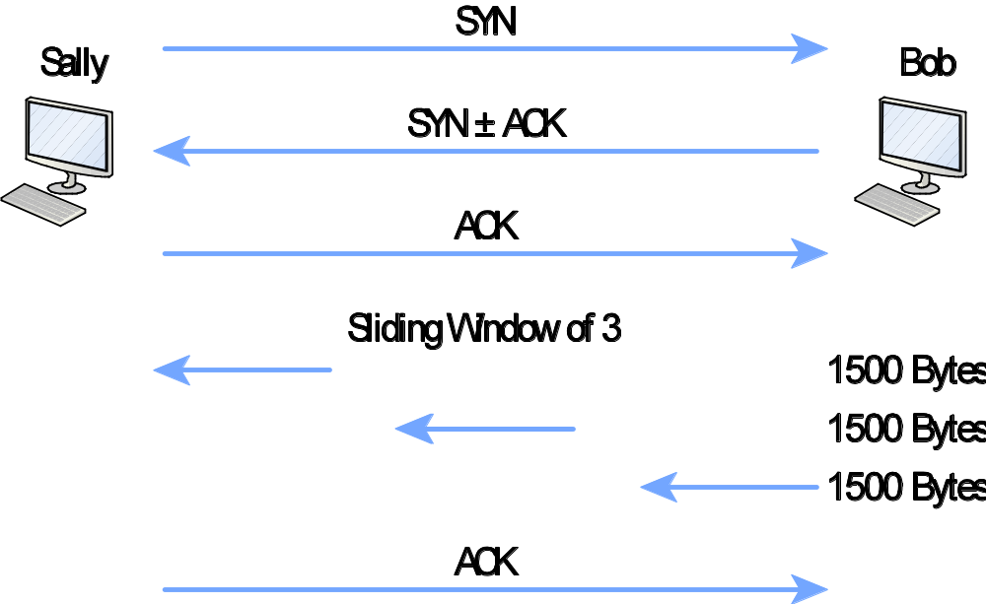
Exploring TCP
TCP sliding window

Slide 7
Exploring UDP
Does not provide guaranteed delivery
No three-way handshake
Unreliable
Best-effort delivery
Commonly used with streaming audio and video

Slide 8
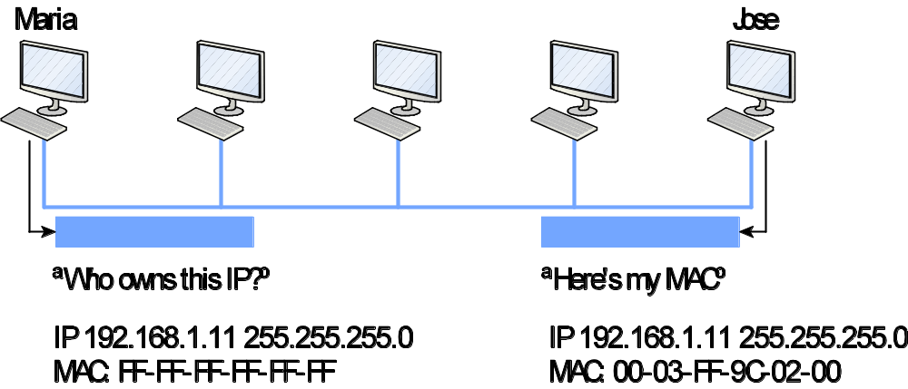
Exploring Common Protocols
ARP
  Translates IP address to a MAC

Slide 9
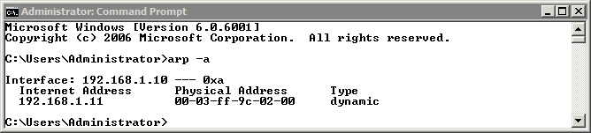
ARP Command
Shows contents of ARP cache

Slide 10
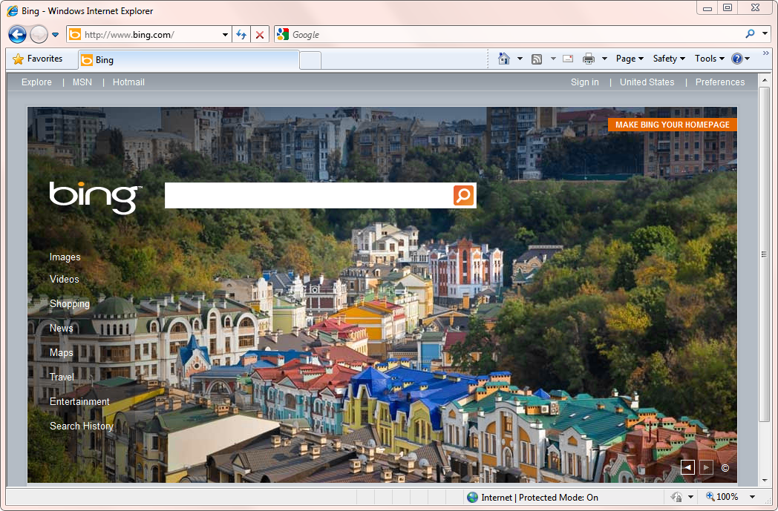
Exploring Common Protocols
HTTP and HTTPS

Slide 11
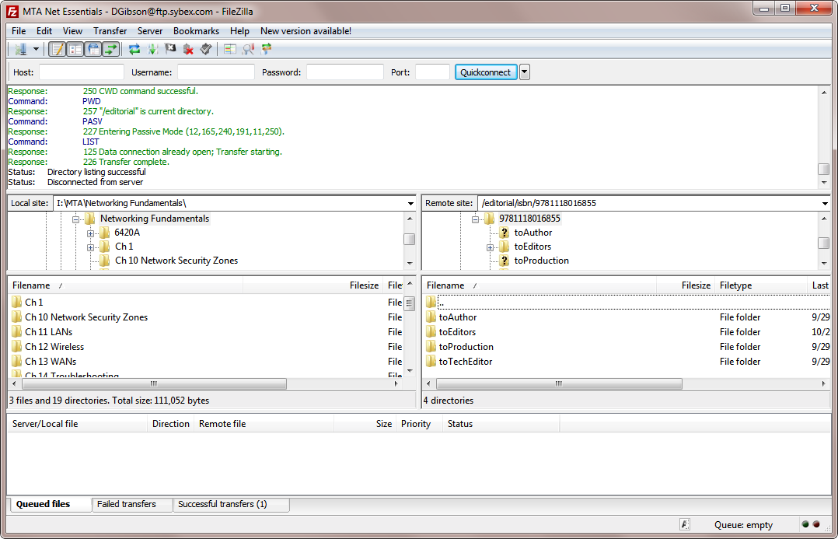
Exploring Common Protocols
FTP and TFTP

Slide 12
Exploring Common Protocols
Telnet
Remote Desktop Services

Slide 13
Exploring Common Protocols
Encryption protocols
  Secure Sockets Layer (SSL)
  Transport Layer Security (TLS)
  Secure Shell (SSH)
  Internet Protocol Security (IPSec)

Slide 14
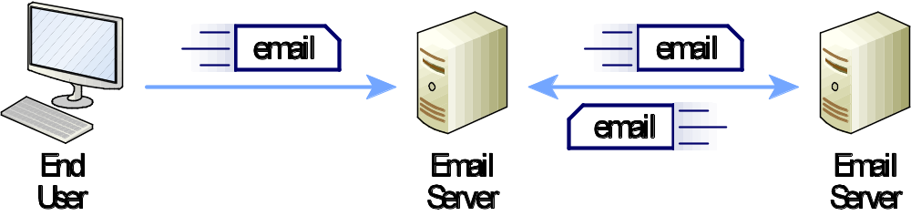
Exploring Common Protocols
Mail protocols
  SMTP
  POP3
  IMAP

Slide 15
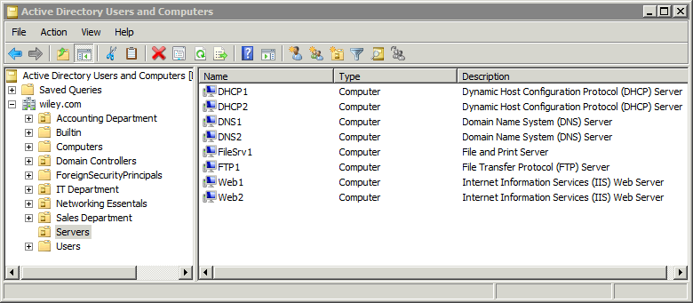
Exploring Common Protocols
Domain Protocols
  LDAP
  Kerberos

Slide 16
Exploring Common Protocols
Tunneling Protocols
  PPTP
  L2TP

Slide 17
Exploring Common Protocols
SNMP
IGMP
ICMP

Slide 18
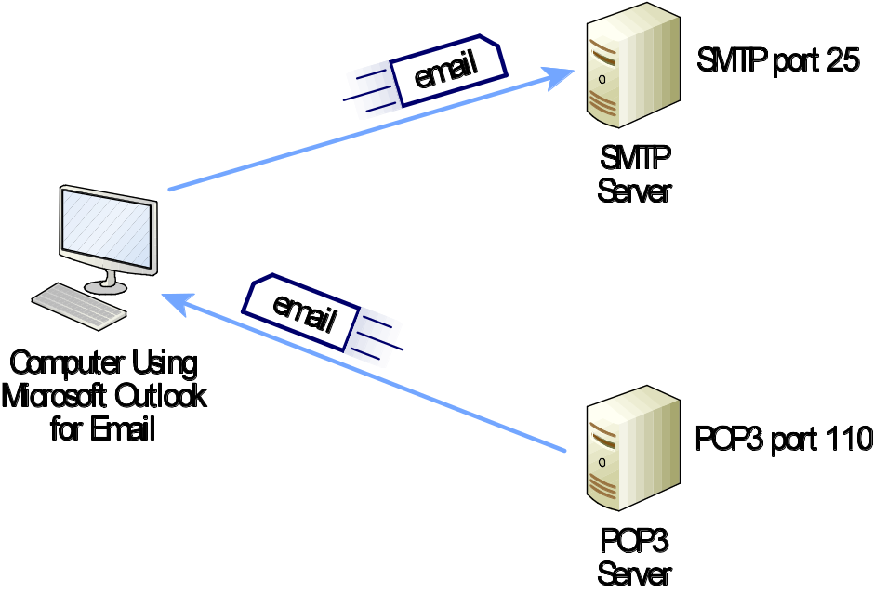
Understanding Ports
TCP and UDP use port numbers
Computes listen on specific ports

Slide 19
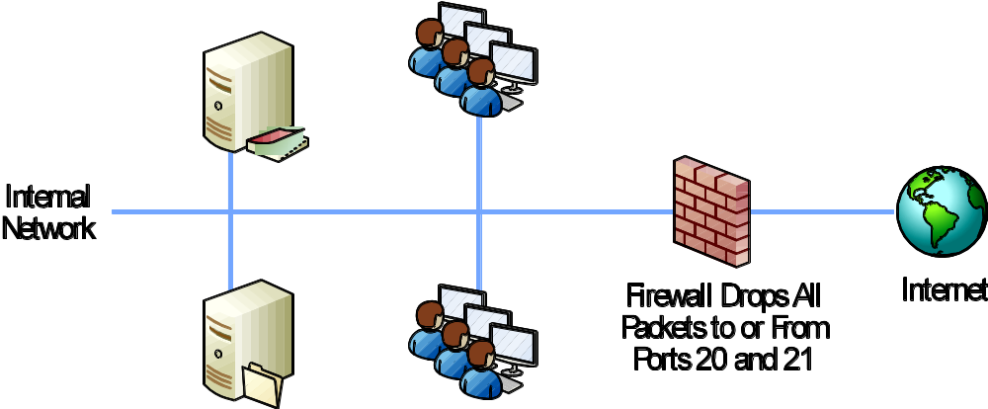
Understanding Ports
Controlling port traffic with a firewall

Slide 20
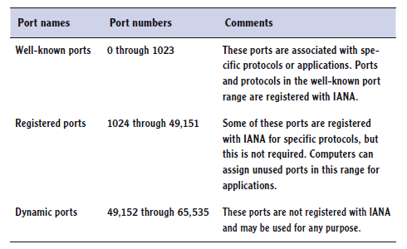
Understanding Ports
Port ranges
Assigned by IANA

Slide 21
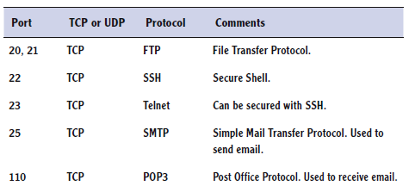
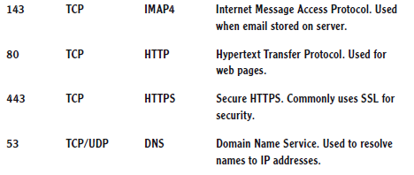
Understanding Ports
Common ports

Slide 22

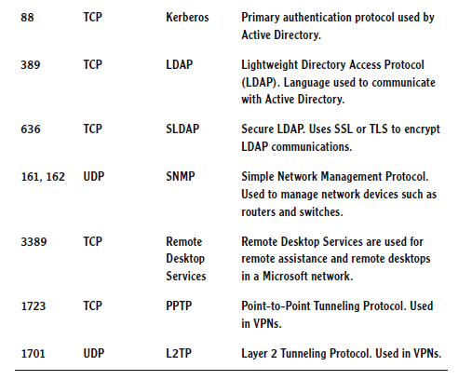
Understanding Ports
Common ports

Slide 23
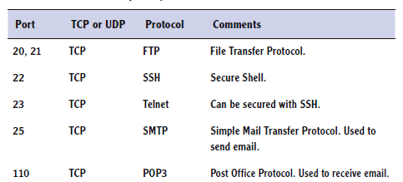
Understanding Ports
Mapping internally used ports and protocols

Slide 24
Chapter 4 Summary
Understanding TCP and UDP
Exploring Common Protocols
Understanding Ports

